Slide 1
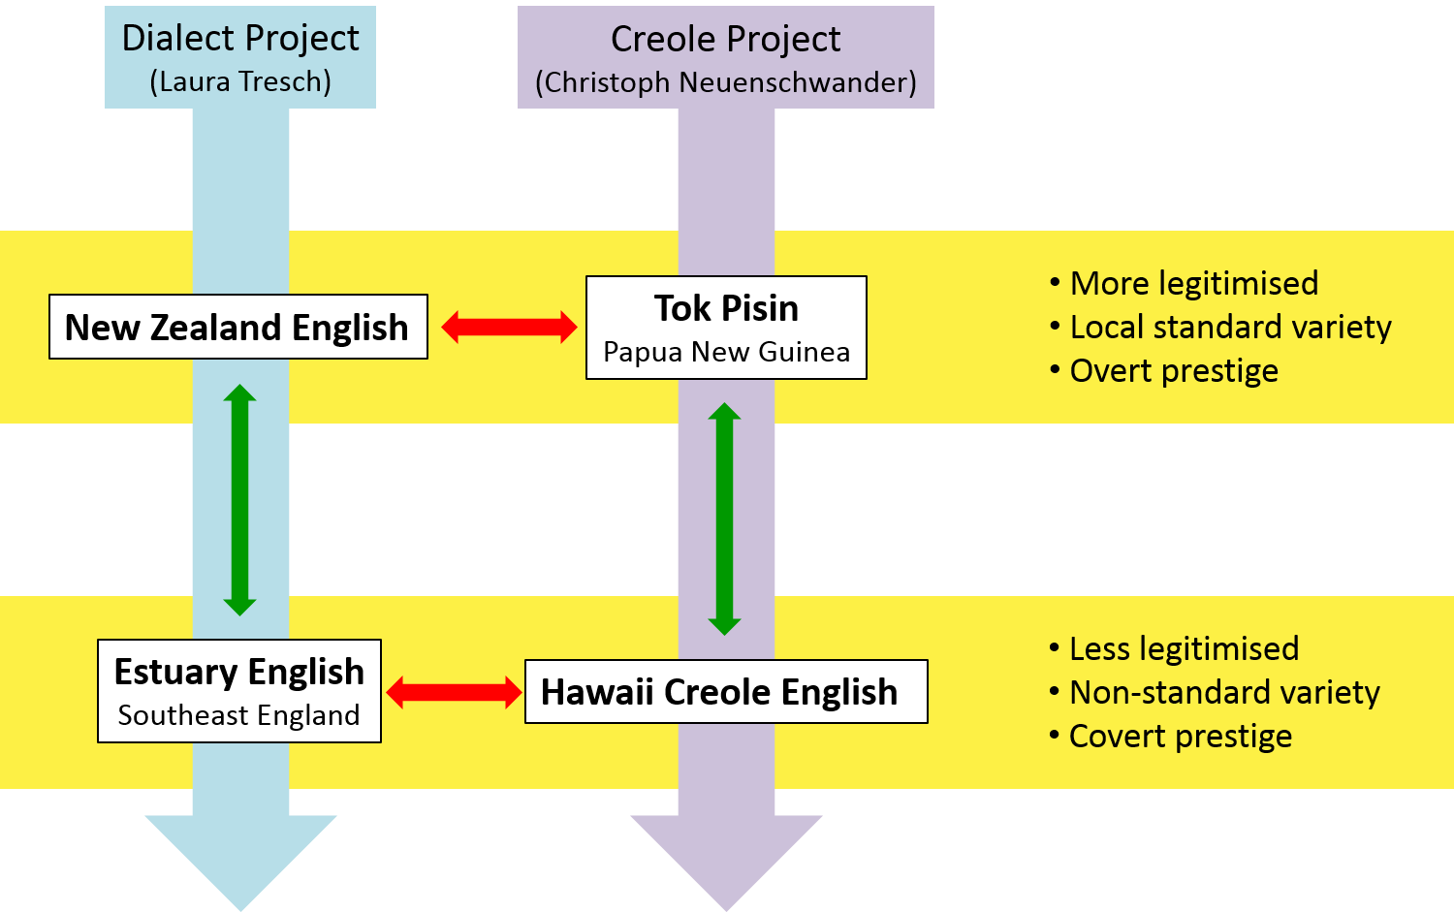
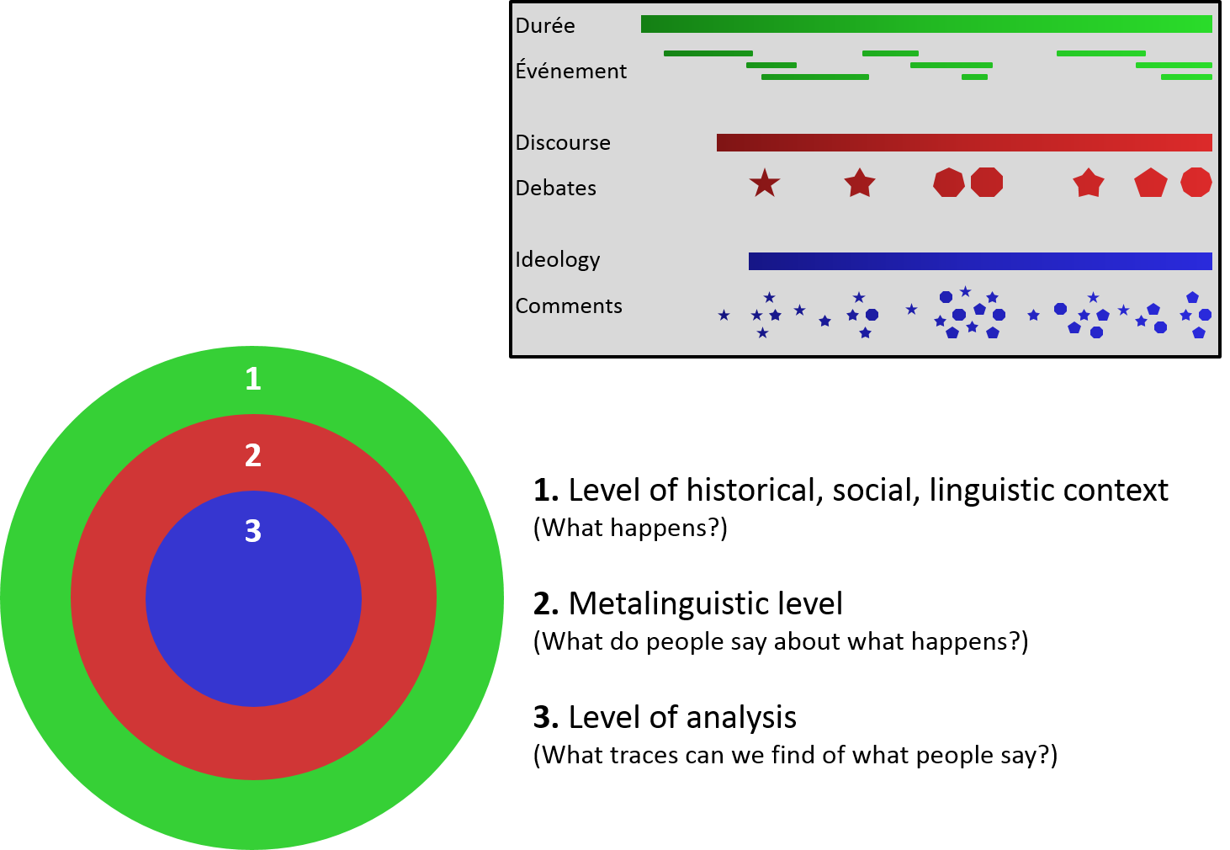
Contact, Mobility and Authenticity Language Ideologies in Koineisation and Creolisation Laura Tresch, Christoph Neuenschwander
Doktoratsprogramm Studies in Language and Society
How are new dialects and new languages represented and evaluated in public discourse?
Taking this question as a starting point, the project Contact, Mobility and Authenticity focuses on four relatively “young” linguistic varieties: two mixed dialects (koines) and two mixed languages (creoles). The project explores debates about language in New Zealand, Papua New Guinea, Hawai’i and London, and compares these four case studies with each other (see Figure 1).
While it is hard to tell how people perceive these varieties, some language ideologies become evident when we look at the public comments people make about these varieties – e.g. in newspapers or on the internet (see Figure 2). We want to find out how ideologies influence language policies, and how notions of unity, authenticity, mobility and power may affect a variety’s legitimacy and status.
Figure 1
Figure 2
Laura Tresch
Christoph Neuenschwander
English Department
Länggassstrasse 49, 3000 Bern 9
laura.tresch@ens.unibe.ch
christoph.neuenschwander@ens.unibe.ch
Center for the Study of Language and Society
Muesmattstrasse 45
3012 Bern
Tel.: 031 631 54 77
www.csls.unibe.ch

